Slide 1
DON & DOFF
MEDICAL EQUIPMENT
AND TRADING
GROUP 7:
PROJECT MANAGER/ Q.A ENGINEER: GONDA, JOHN KENNETH
UI/UX DESIGNER: GRAMATA, RAFAELL CARLOS
REQUIREMENT ANALYST: DE GUZMAN, JOHN RICHARD
WEB DEVELOPER: GAMBOA, NICHOLAS JOHAN

Slide 2
TOPIC: TRADING COMPANY (MEDICAL SUPPLIES AND SERVICES)
Problem Statement: Don & Doff Medical Equipment and Trading started their business this year and they started selling medical supplies. They take orders by contacting customers with the help of their friends, relatives and other acquaintance, referrals. As they continue, the company started to think on how could their business could grow more and so that people would notice their business and what kind of products are they selling. So they decided to have a website that would help their business grow and to sell their products online so that they could attract more customers. They also wanted to monitor every products on their inventory, how many products are sold and how many products are still available.
As our team gathered all of this informations, we decided to make them a website that will help their business and so that they could start selling their products online and to be able to monitor their inventories in an easier way. We think that it would also be a good idea since it will display and indicates all the necessary informations regarding such medical products and their prices. By providing all of that, we think that it is more convenient for the company and for the customers that wishes to buy medical products provided with the product descriptions as their guide.

Slide 3
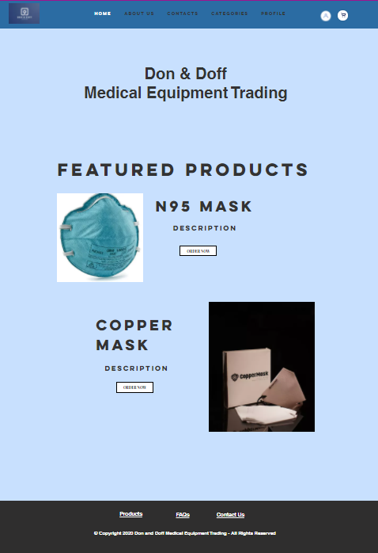
HOMEPAGE
CONTAINS:
NAME OF THE TRADING BUSINESS
A. MENU BAR
HOME
ABOUT US
MEDICAL SUPPLIES PRODUCT LIST (BY CATEGORY
CONTACTS
PROFILE
B. FEATURED PRODUCTS

Slide 4
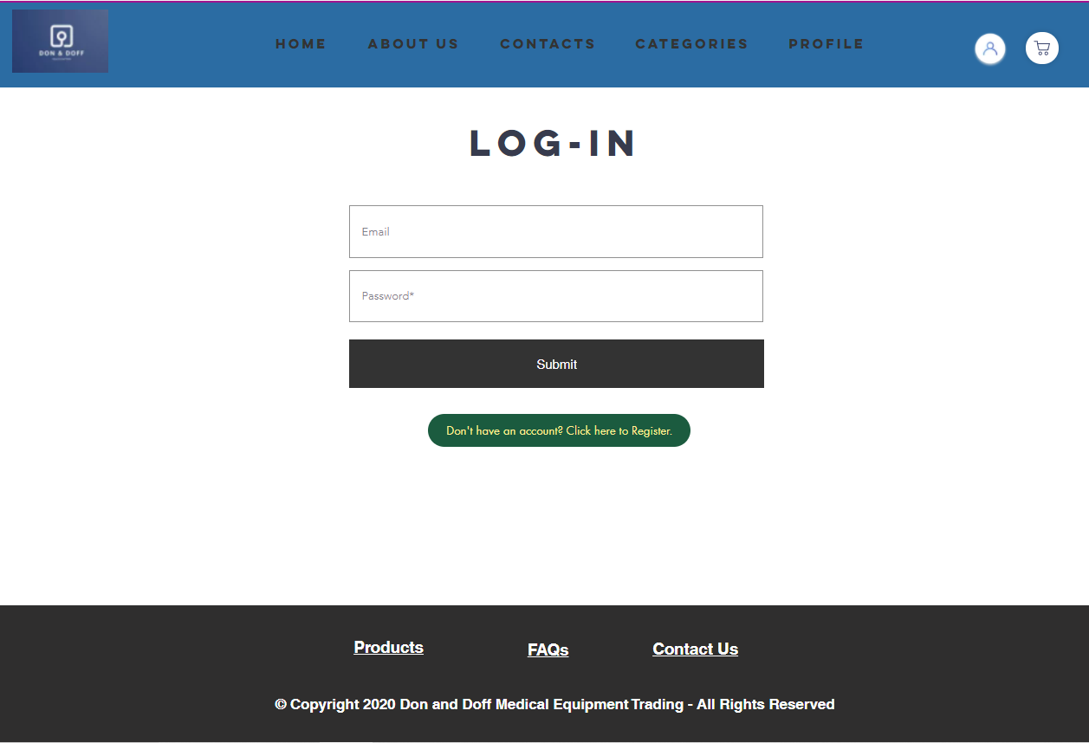
LOGIN
CONTAINS:
Email for login and password for account.
Register button
Submit button for submission

Slide 5
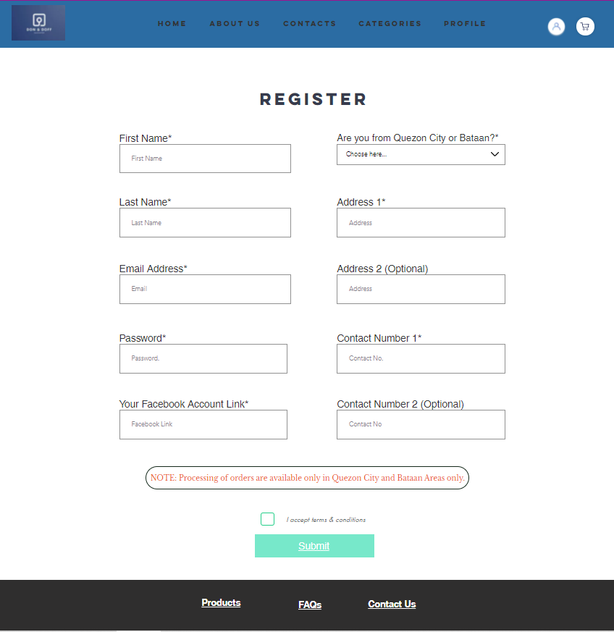
SIGN-UP
CONTAINS:
Fill out form to register and make an personal account for Don & Off
First Name
Last Name
Address
Contact Numbers
Email Address
Password

Slide 6
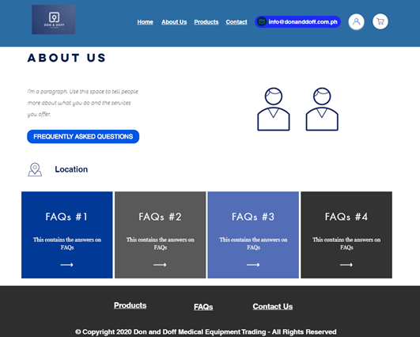
ABOUT US
CONTAINS:
Business background information
Picture of business owner
Location
FAQs

Slide 7
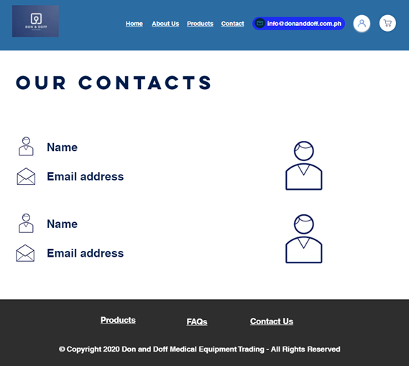
CONTACTS
CONTAINS:
Email addresses, contact numbers, and location of company

Slide 8
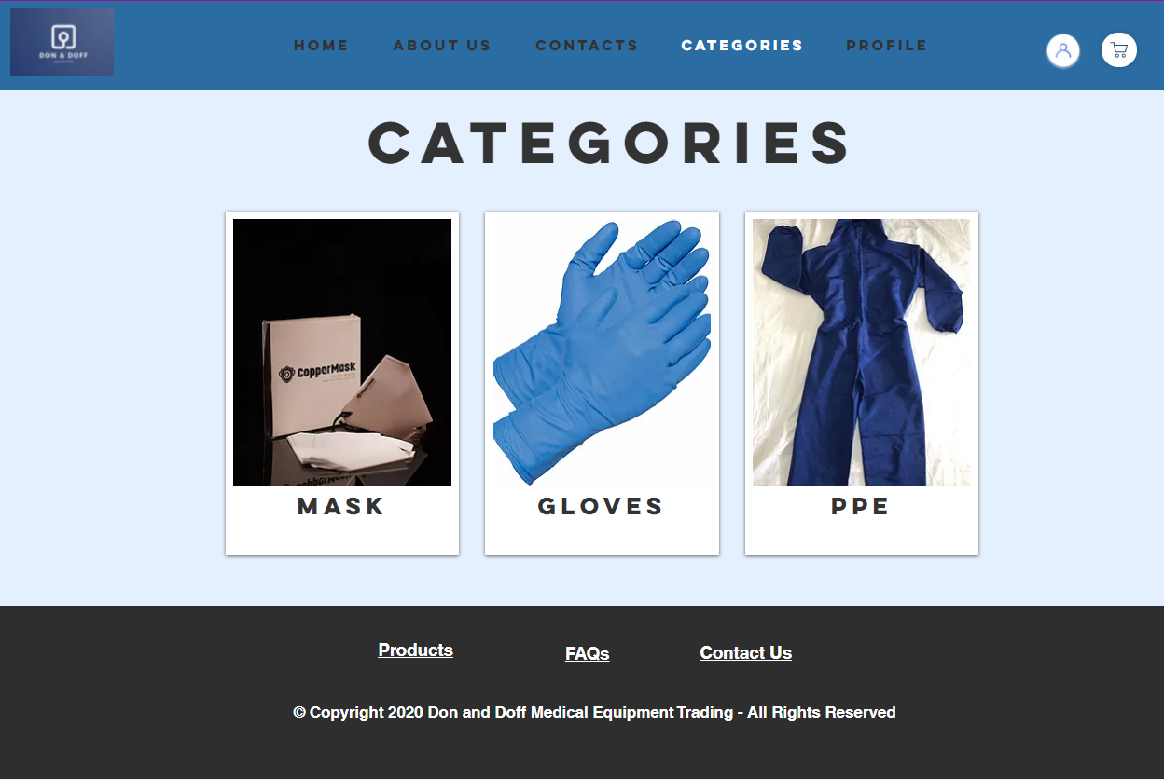
CATEGORIES
CONTAINS:
Categories of the product

Slide 9
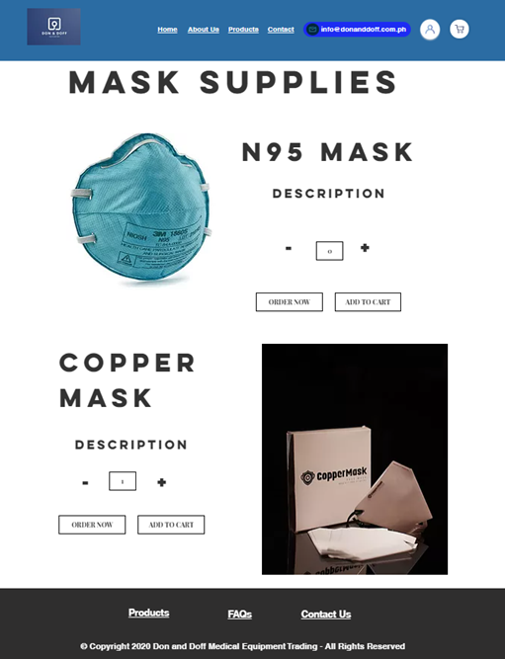
CATEGORY PAGE(MASK SUPPLIES)
CONTAINS:
Set of selected category
Image and description of each product
Place the desired amount of orders
Order Now (button)
Add to Cart (button)

Slide 10
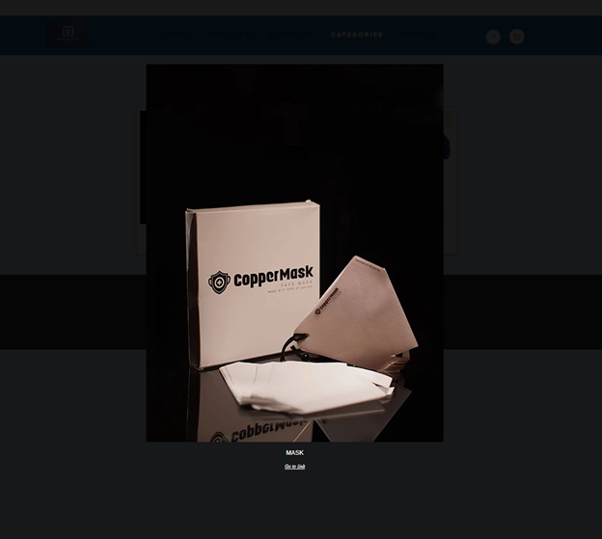

Slide 11
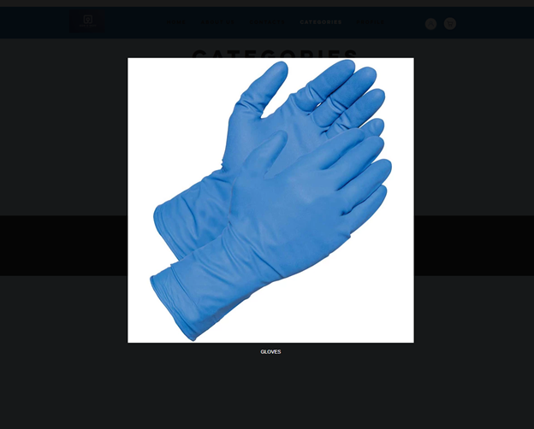

Slide 12
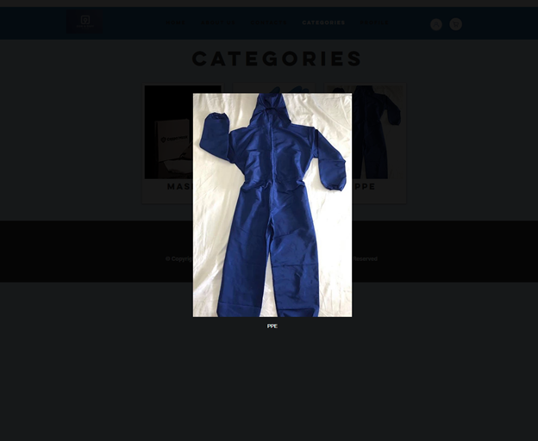

Slide 13
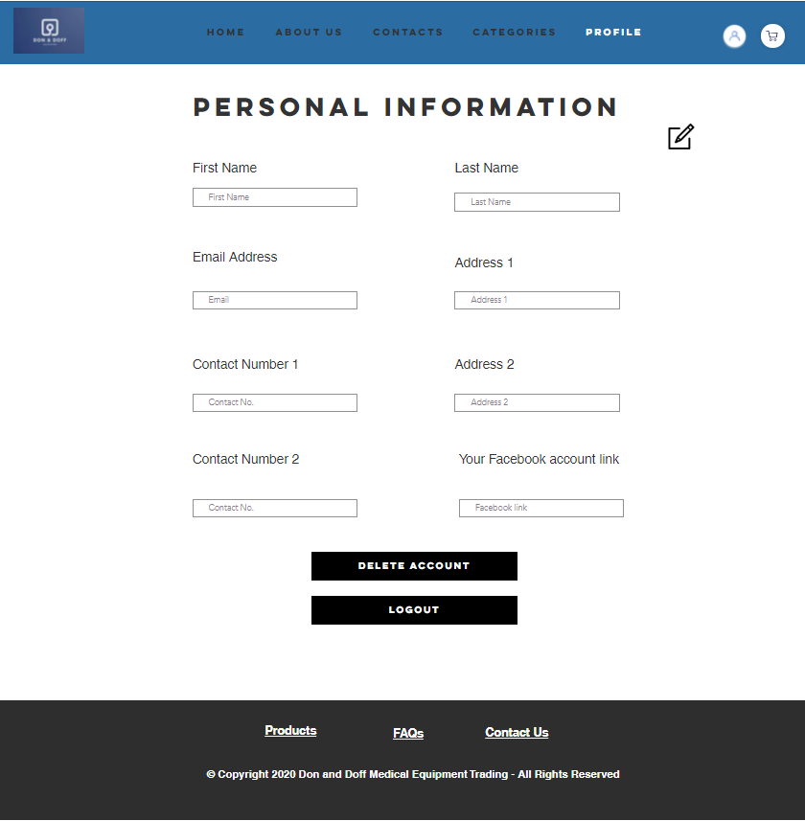
MY ACCOUNT
CONTAINS:
Personal Information
First Name
Last Name
Email Address
Address
Contact Numbers
Facebook Link
Delete account (button)
Logout (button)

Slide 14
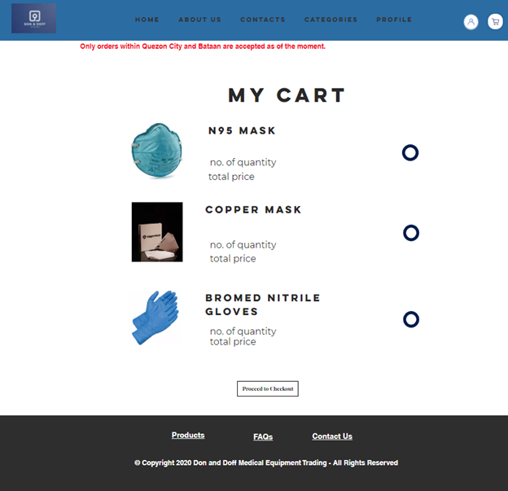
CART CHECKOUT PAGE
CONTAINS:
My Cart
Item/s chosen by Client
Quantity of items per product
Total price per product
Estimated total
Remove product from cart
Proceed to Checkout

Slide 15
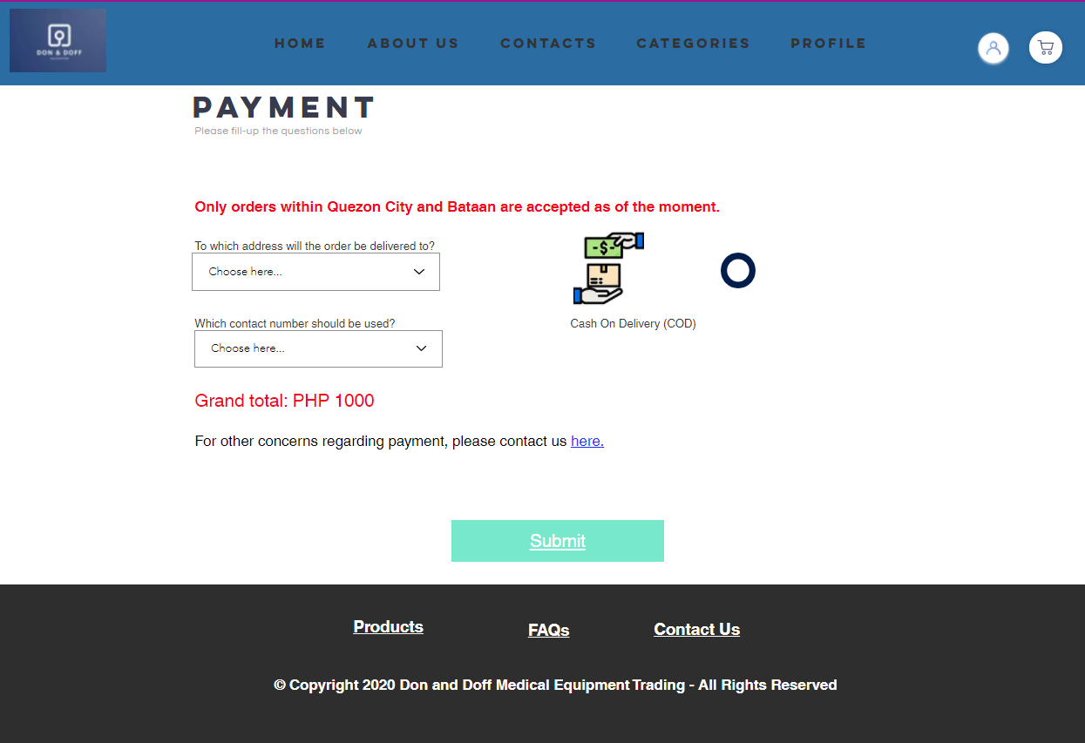
PAYMENT
CONTAINS:
PAYMENT
Drop down list of address and contact number
Grand total
For other concern regarding payment a contact link is provided.

Slide 16
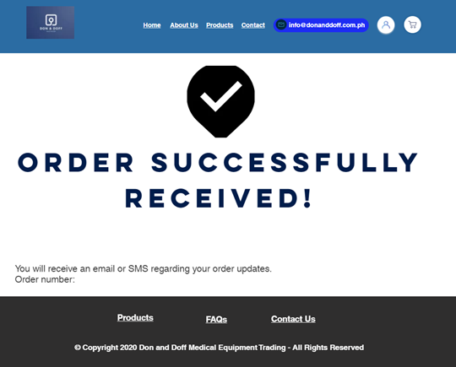
ORDER SUCCESS PAGE
CONTAINS:
• Confirmation that the order was successfully received

Slide 17
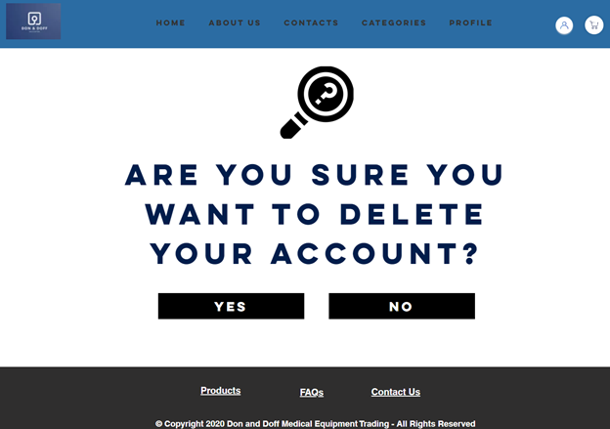
ACCOUNT DELETE PAGE

Slide 18
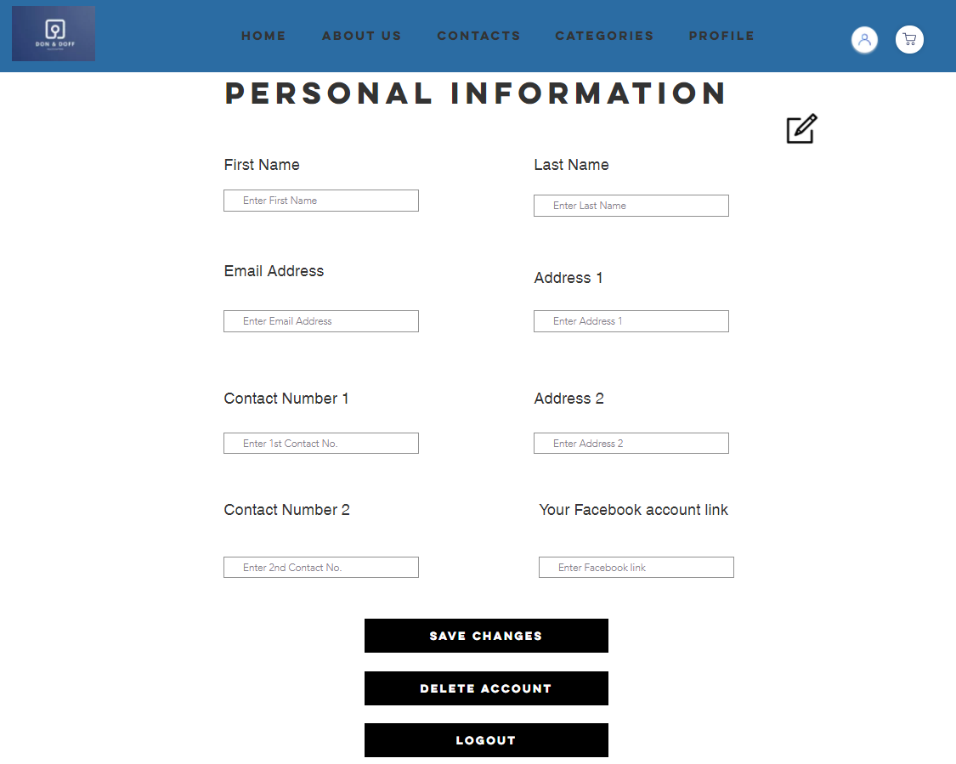
EDIT PROFILE PAGE

Slide 19
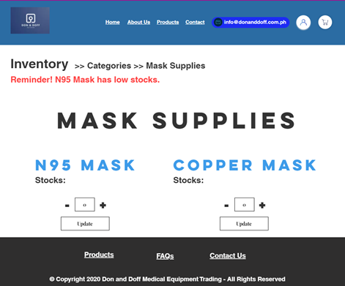
INVENTORY PAGE (ADMIN)
CONTAINS:
Displays the number of available stocks
Notification that a certain product is low on stocks
Will input the desired amount in order to update the stocks

Slide 20
SAMPLE INTERACTIVE WEBSITE USING WIX
https://kennethgonda2728.wixsite.com/mysite

Slide 21
Thank you!

